Slide 1
Controller modes:
Discontinous controller modes (ON-OFF controller (two position, Three position)
Continious controller modes (P,PI,PD,PID)
Application:
Analoge controller
Discrete controller

Slide 2
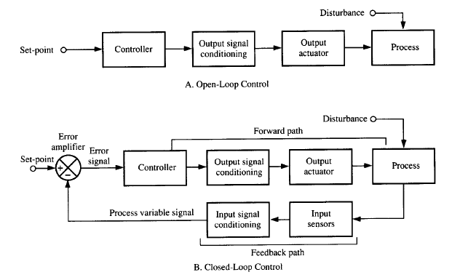
Controller (application) Analog/Digital

Slide 3
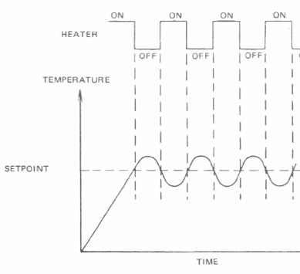
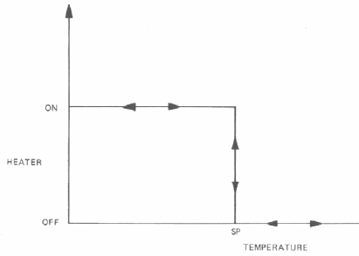
Simple ON/OFF controller (Example: Temperature controller)

Slide 4
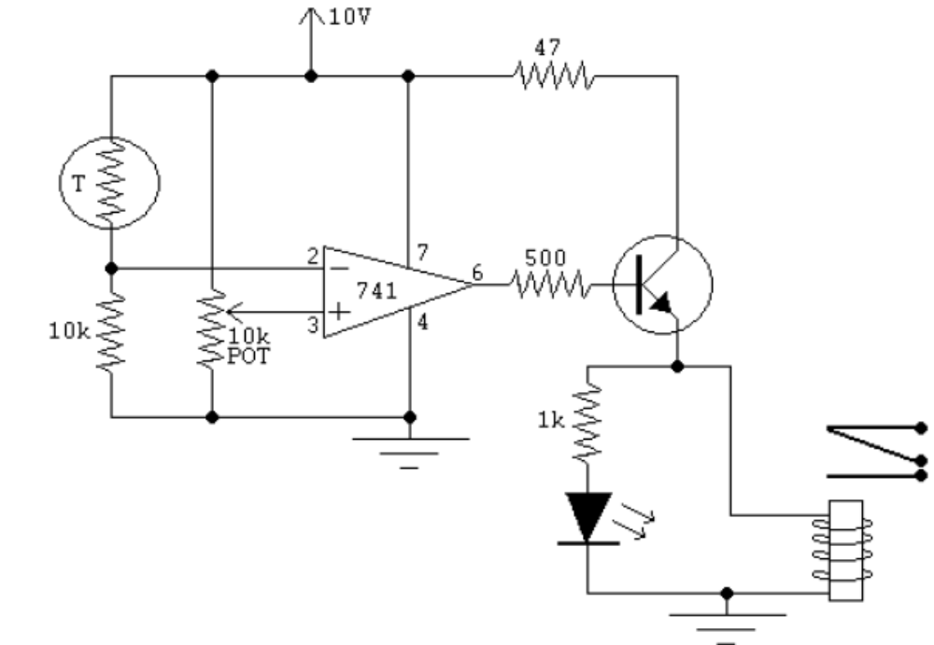
Realization by an OP-AMP (A comparator without feedback)
Sensor
Ref value
Indicator LED
Relay
NTC Thermistor ( temp sensor) + Potan. (Ref value) Op-Amp (simple on-off controller without feedback)

Slide 5
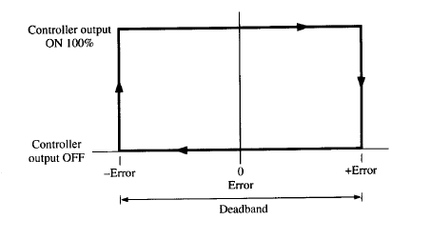
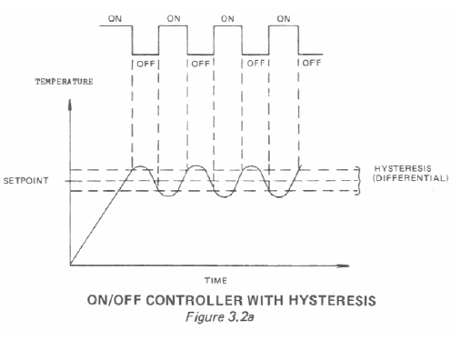
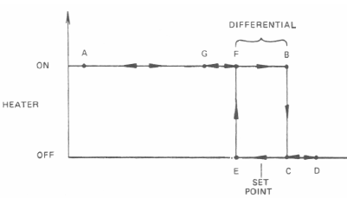
ON/OFF controller with
deadband (Hysteresis)

Slide 6
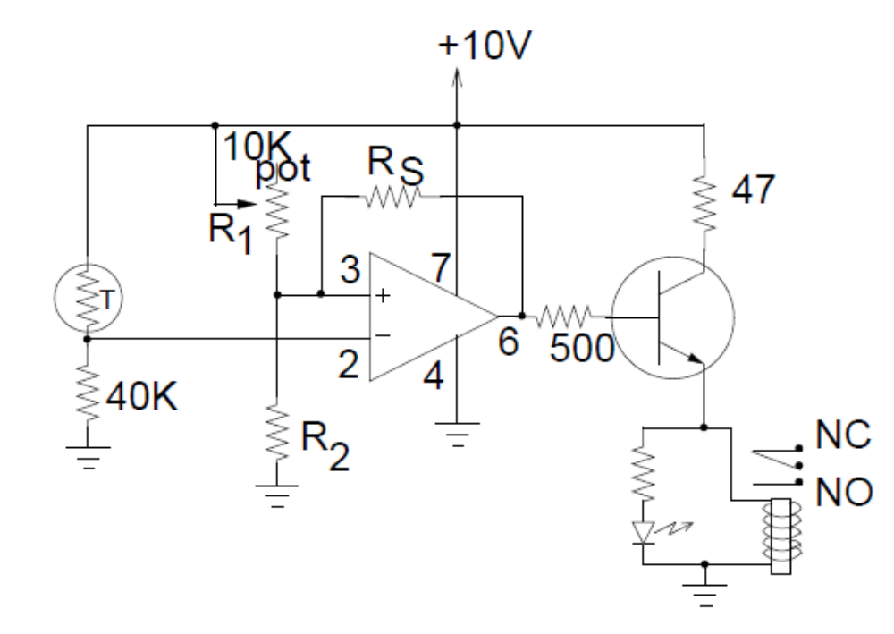
Practical circuit: deadband (Hysteresis) controller

Slide 7

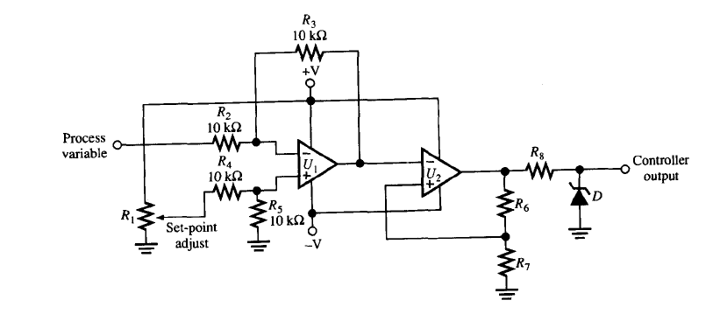
Simple on-off controller with deadband ( analog controller)
Clamp circuit
Error detection circuit
on-off controller with deadband

Slide 8
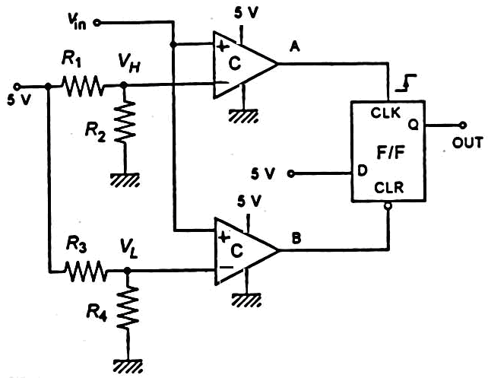
Example:
Verilen devre, sıcaklık denetimi için kullanılmıştır. Sıcaklık algılayıcısının transfer fonksiyonu 15 mV/C olarak verilmiştir. Denetim devresinin çıkışı bir fanı denetlemektedir. Fanın 70C de ON (Q=1) ve 40 C de OFF(Q=0) olması istenmektedir.

Slide 9
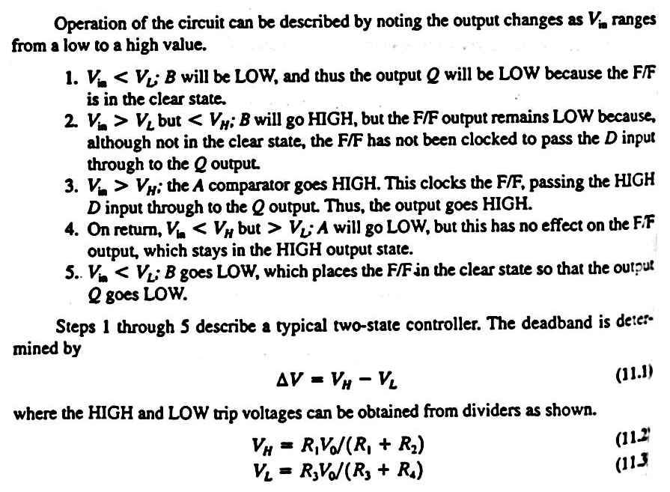

Slide 10
Normal ON-OFF
denetimin algoritması
T = ölçülen sıcaklık
T0 =referans değer
Function heater(T,T0)
IF T >T0
Turne_on_heater
Else
Turne_off_heater
End if
End heater
Hyasteresis aralıklı ON-OFF
denetimin algoritması
DEGIN DO FOREVER Measure T IF T < T_{ref}-ΔT Turn ON device ELSE IF T> T_{ref}+ΔT Turn OFF device END IF ENDDO

Slide 11
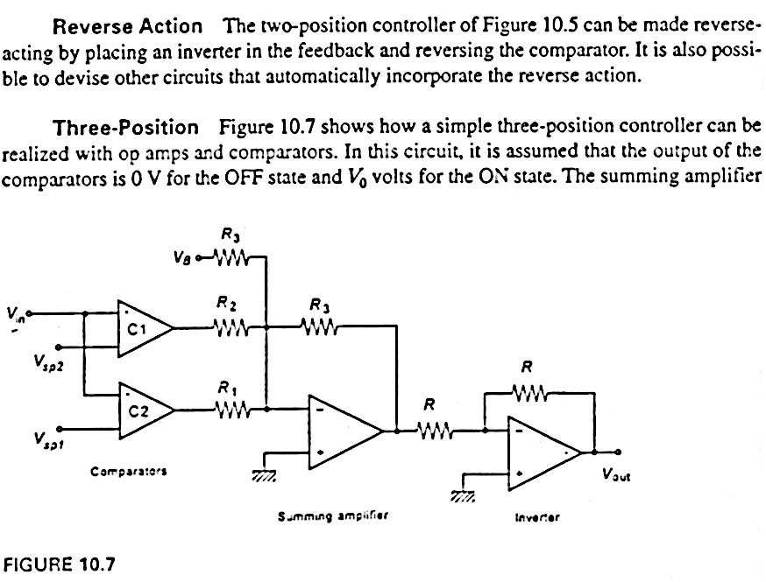
Three position controller
+
+
+
+

Slide 12
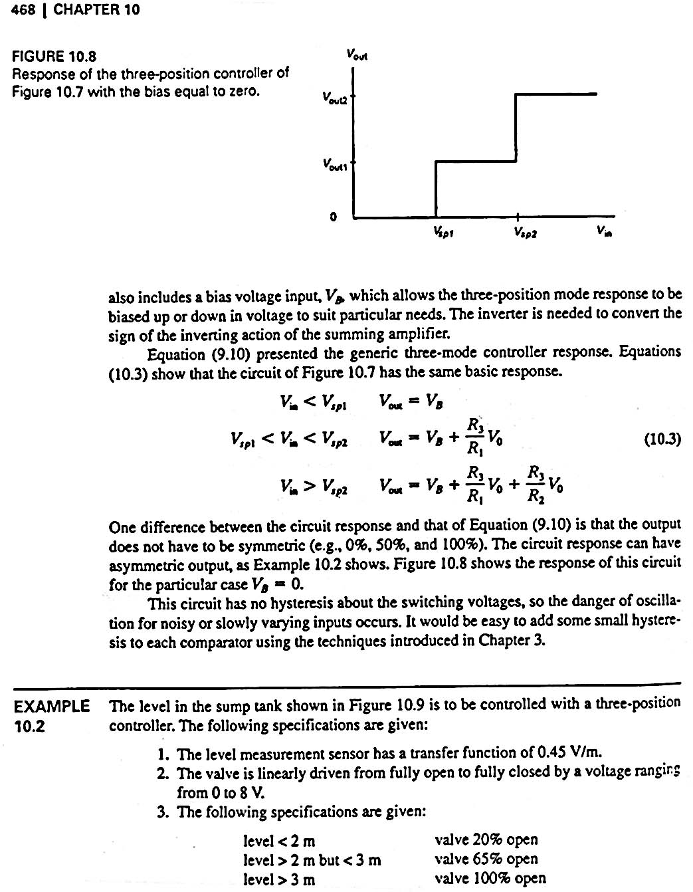

Slide 13
Three position controller (analog and digital)
İf (Vin <vsp1)
Vout = VB
Else if (vsp1< vin<vsp2)
vout1 = vB+(R3/R1)*Vo
Else vin> Vsp2)
Vout2 = VB+…………..
Vsp1<Vsp2

Slide 14
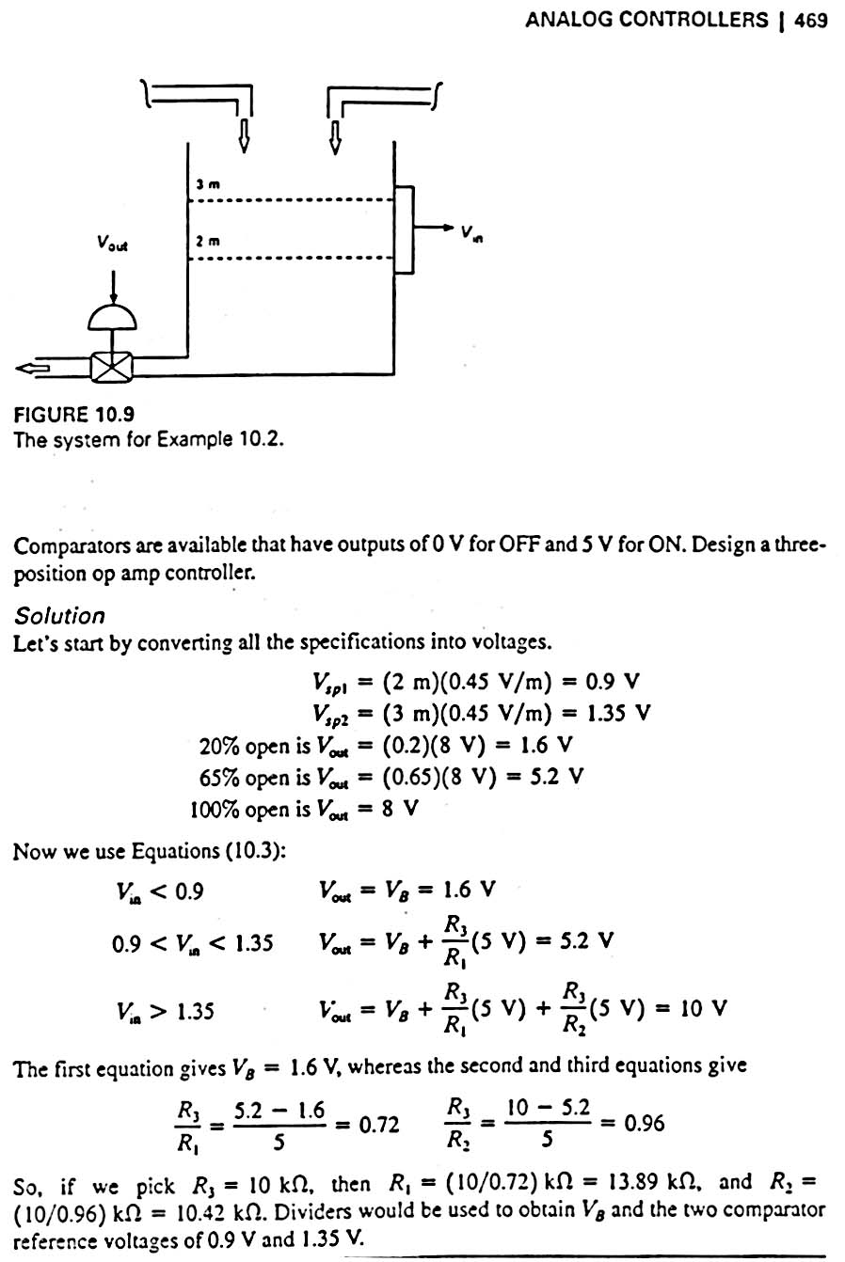
Example: Three position controller

Slide 15
Sensor 0.45 V/m

Slide 17
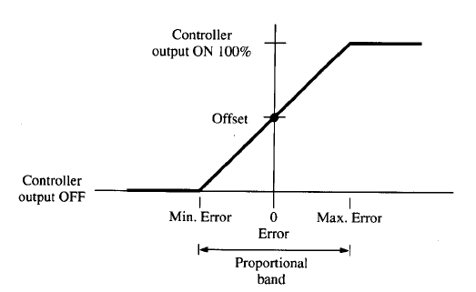
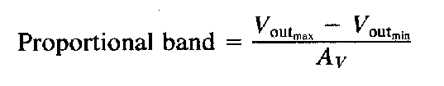
ON-OFF Controller …….. Proportional controller
……. Continous
Discontinous
Kp=1/PB
Gain =1/proportional band

Slide 18

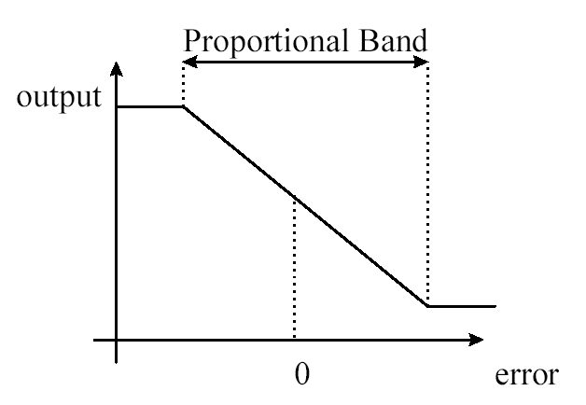
Proportional Controller
This is the simplest form of feedback control. The control signal, u(t), is made to be linearly proportional to the error in the measured output:
The transfer function for the controller is given by: K_{P}
A large error results in a large output from the controller.
A small error result in a small output from the controller.
The graph below shows how the output of the controller varies with error:

Slide 19
P0 = offset value when error = 0
In software:
Proportional gain, integral gain , derivative gain firstly shown as variables.(P0 =output of controller when error =0)
Read set point
Read process variable
Calculate error (DE = DV-DSP);
P = P0+U; P0 ;output with no error
Output P (to output port or Other module like(PWM,..)
Goto 1

Slide 20

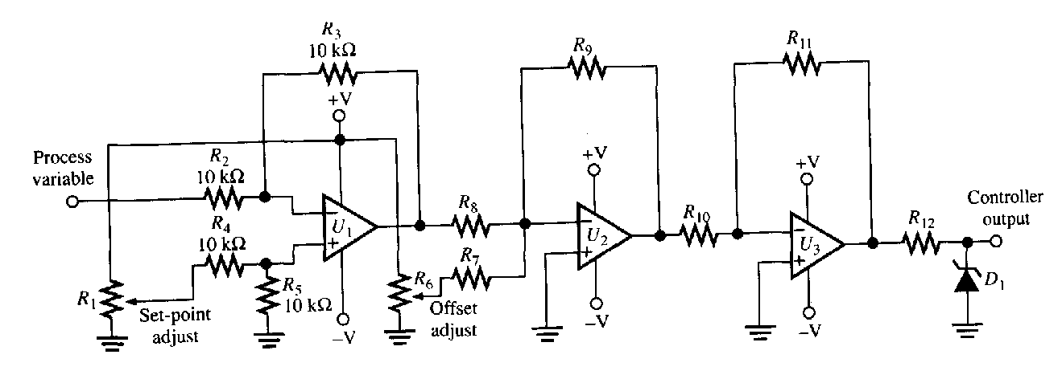
Error detection circuit
Proportional controller

Slide 21
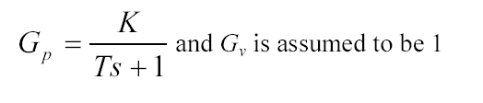
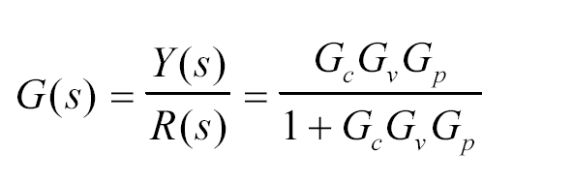

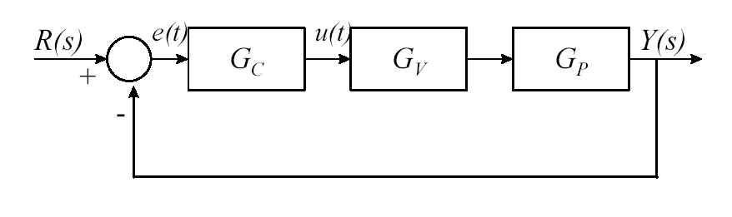
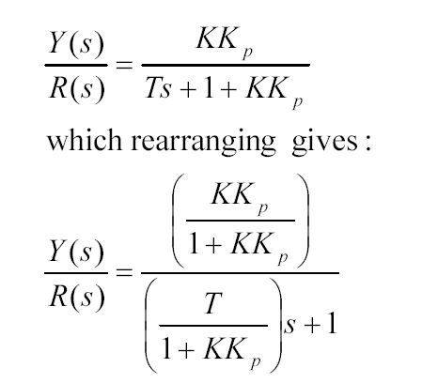
The response of a first-order system under proportional control:
With proportional control the CLTF is equal to:
R(s) = 1 for step response
Controller control element process
Actuator
For Gv = 1

Slide 22
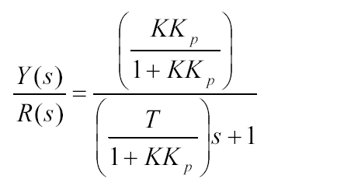
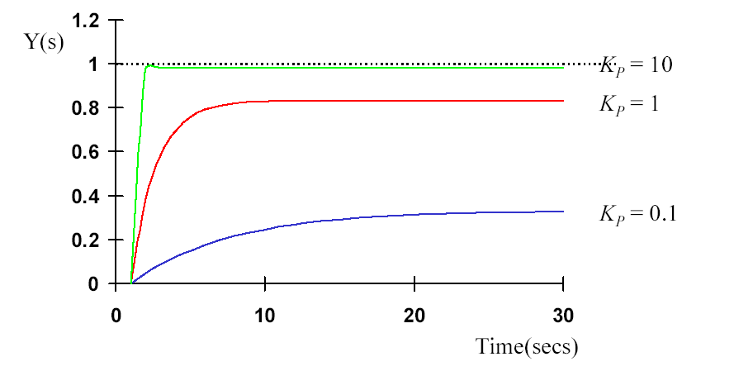
1
time constant for first order system
The CLTF shows that as the gain of the controller is increased, the overall gain of the system approaches unity and the time constant gets smaller and smaller.The addition of proportional control also affects the characteristic equation, which implies that the response of the system will also change. The time constant is reduced as the gain of the controller increases and therefore the system response will be faster.

Slide 23
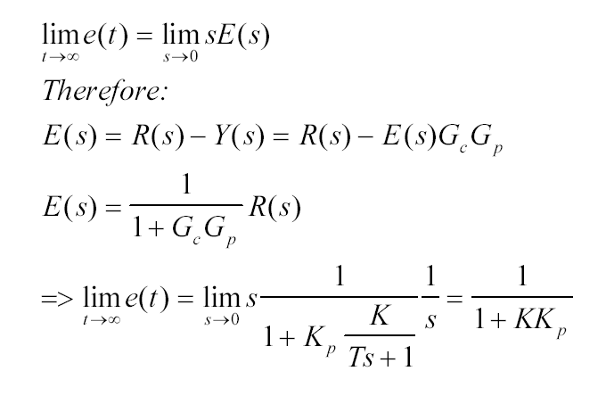
Steady State Error.
The purpose of the controller is to maintain the system output at the setpoint value. To determine whether or not a proportional controller achieves this it is necessary to determine the steady state value of the
R(s) = 1/s step response

Slide 24

For first order system: with GP:

Slide 25
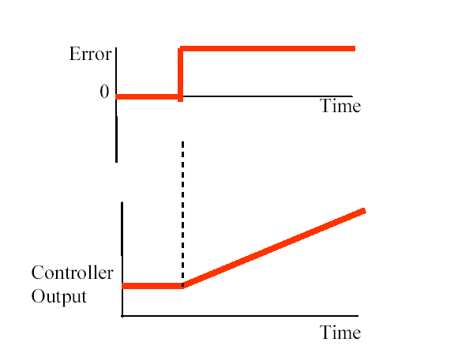
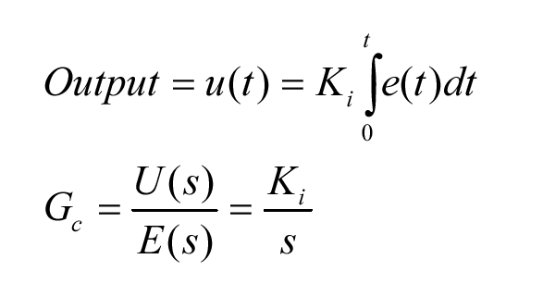
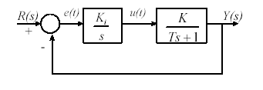
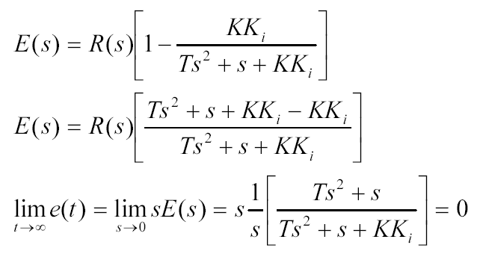
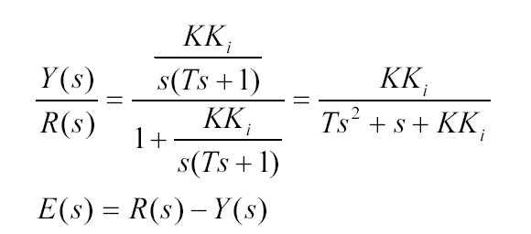
Integral Control: Input R(S)is step function

Slide 26


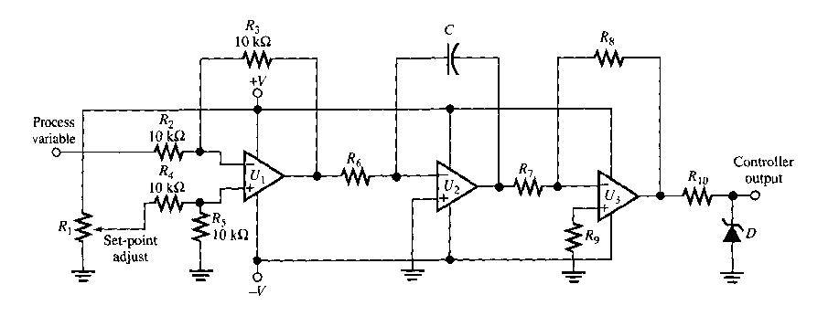
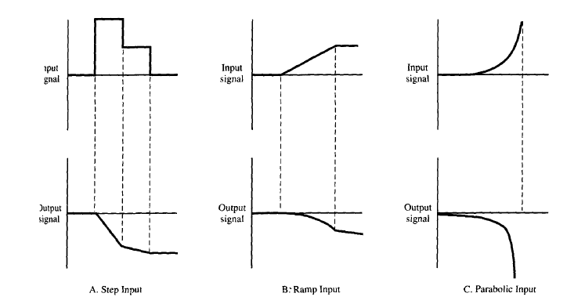
If error is constant:

Slide 27
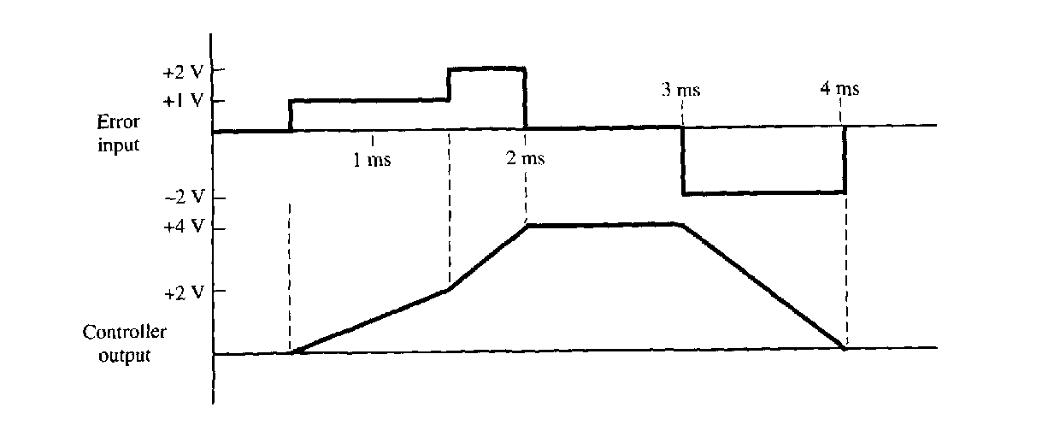

Slide 28

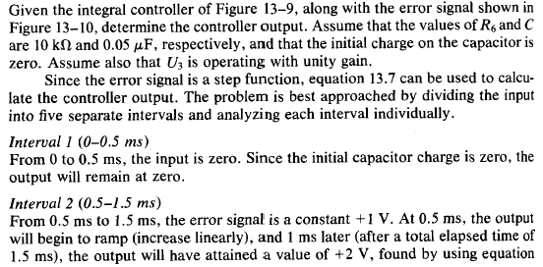
Example:

Slide 29

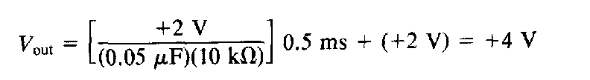

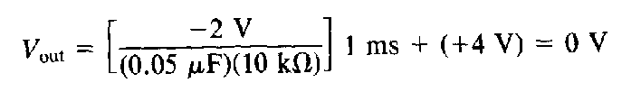

Slide 30
In software (Integral control)
Read set point
Read process variable
Calculate error (DE = DV-DSP)
Sum =Sum+DE
PI = KI.DT.SUM
Output PI
Delay (DT)
Goto 1

Slide 31

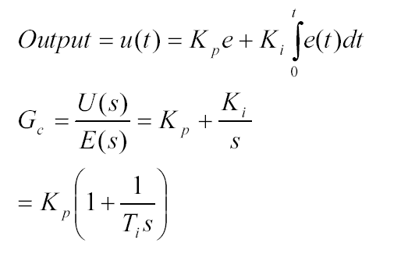
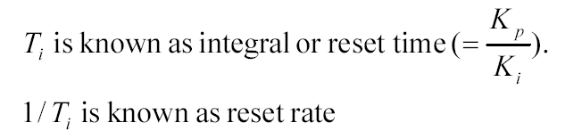
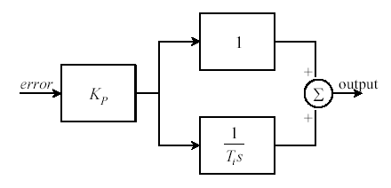
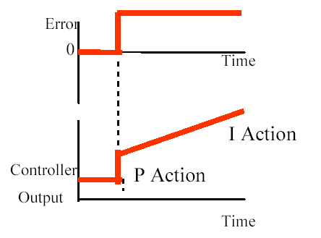
Controller

Slide 32
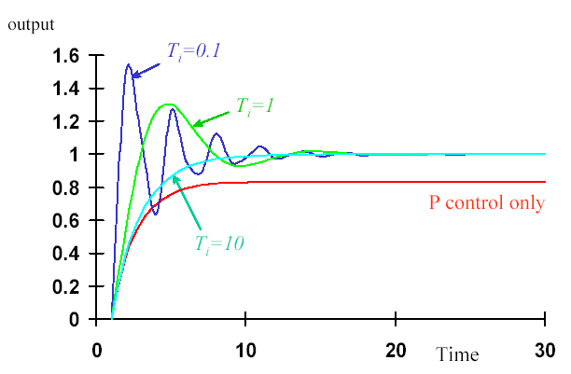
Step function as input

Slide 33
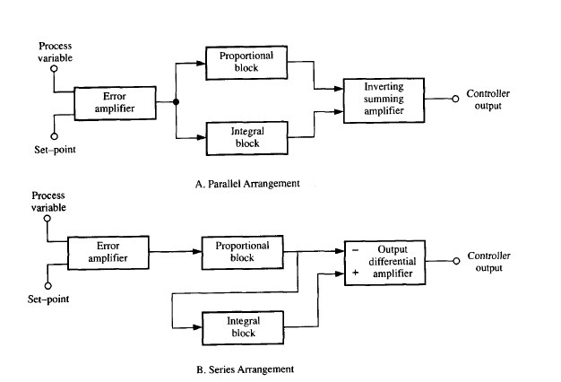

Slide 34
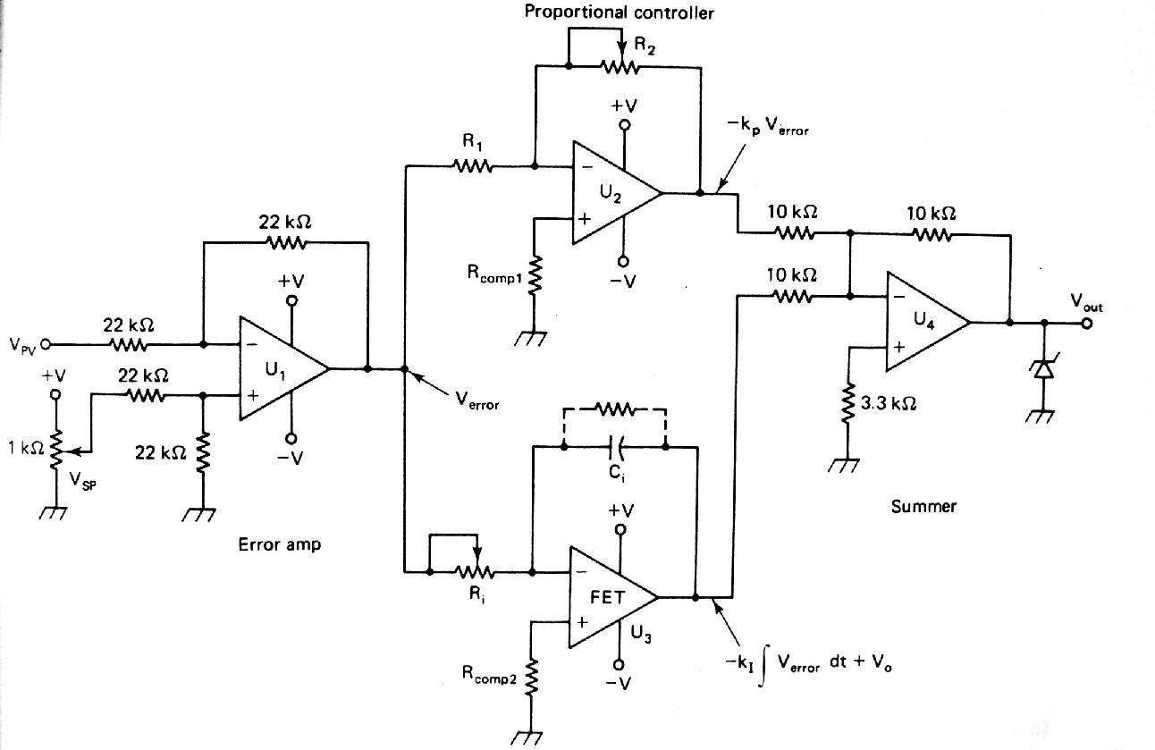
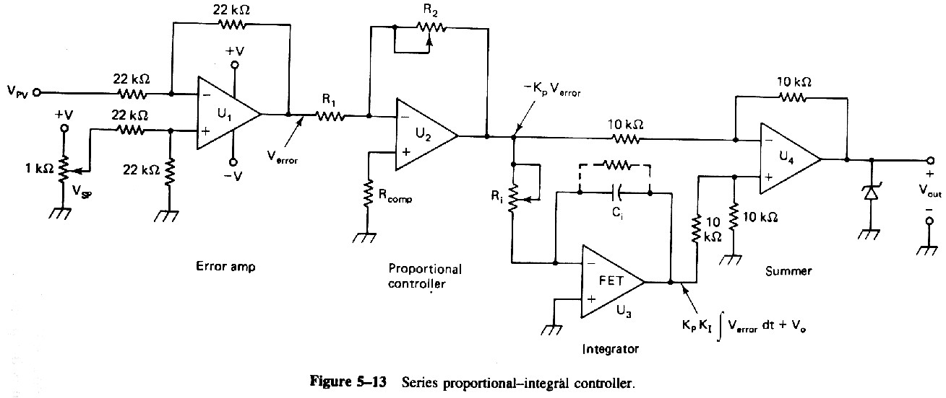
Parallel PI controller
Serial PI controller

Slide 35
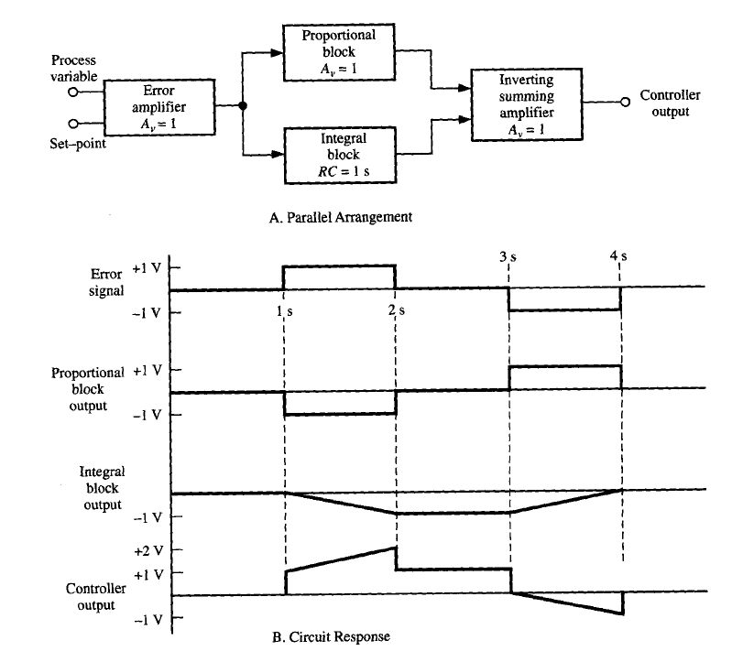
(Parallel)

Slide 36
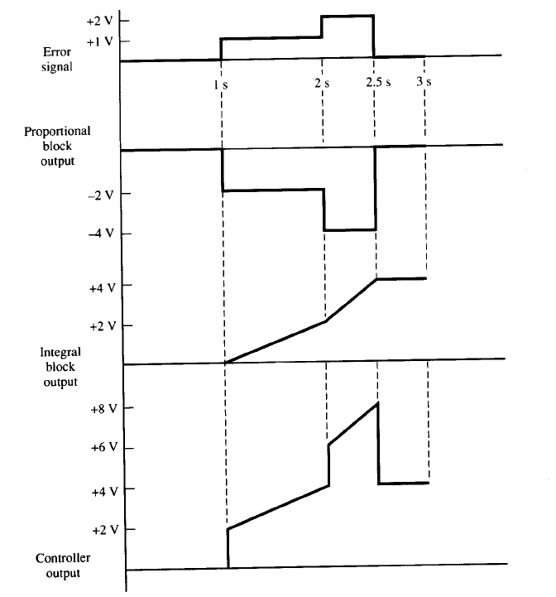
Example:

Slide 37
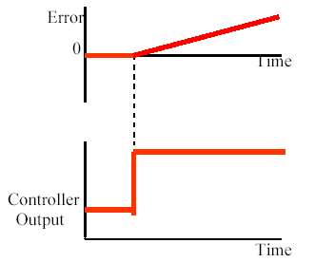
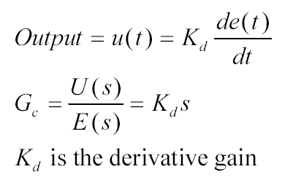
Derivative Control:
The final element of a 3-term controller is derivative action. Derivative control attempts to anticipate future error values from the rate of change of error in the control algorithm. The output of a derivative controller is set to be proportional to the rate of change of error:
Derivative control will be insensitive to constant or slowly changing errors and is therefore typically used with other forms of controller.

Slide 38
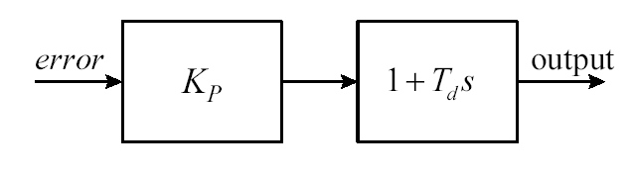
Proportional plus Derivative (PD) Control:
proportional control can produce oscillatory behaviour.
Derivative control increases stability and consequently reduces oscillations, for those systems where it is important to minimise the amount of oscillation, PD control is applied. It should be noted that PD control will produce a steady state error unless the system contains

Slide 39
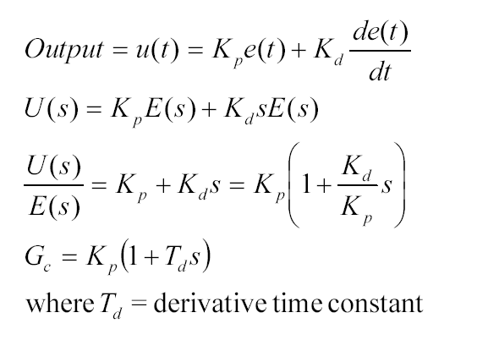


Slide 40


Proportional plus Integral plus Derivative (PID) Control
The output of a PID controller is determined as follows:

Slide 41



